Slide 2
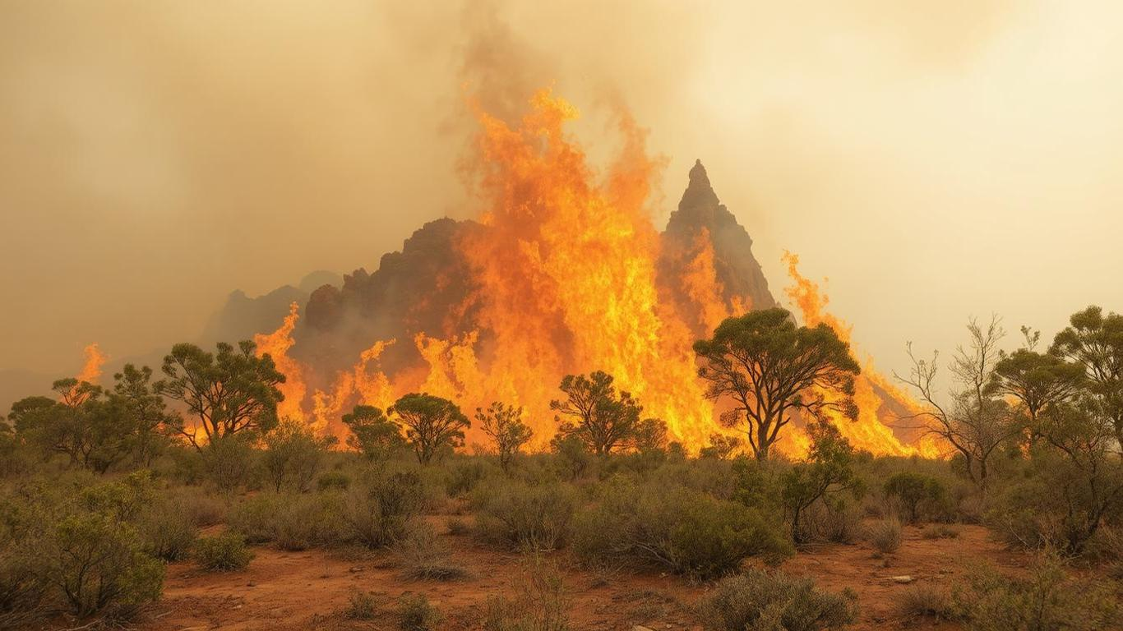


Slide 3
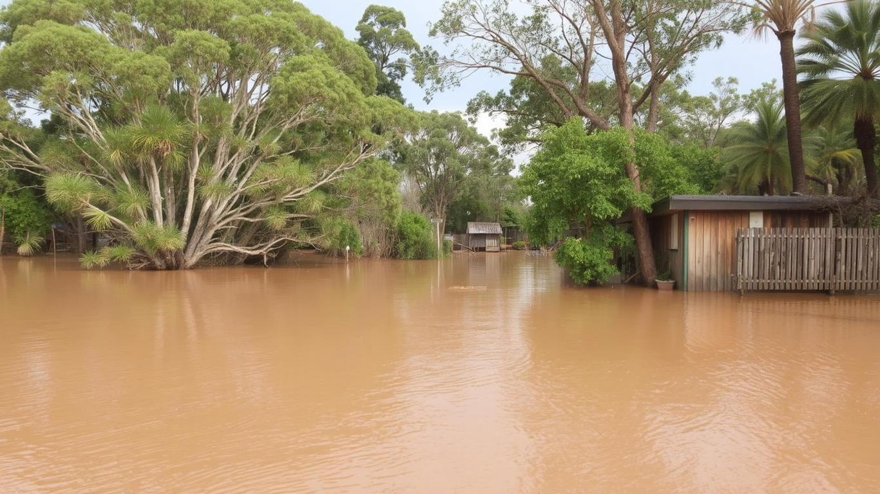

Slide 4
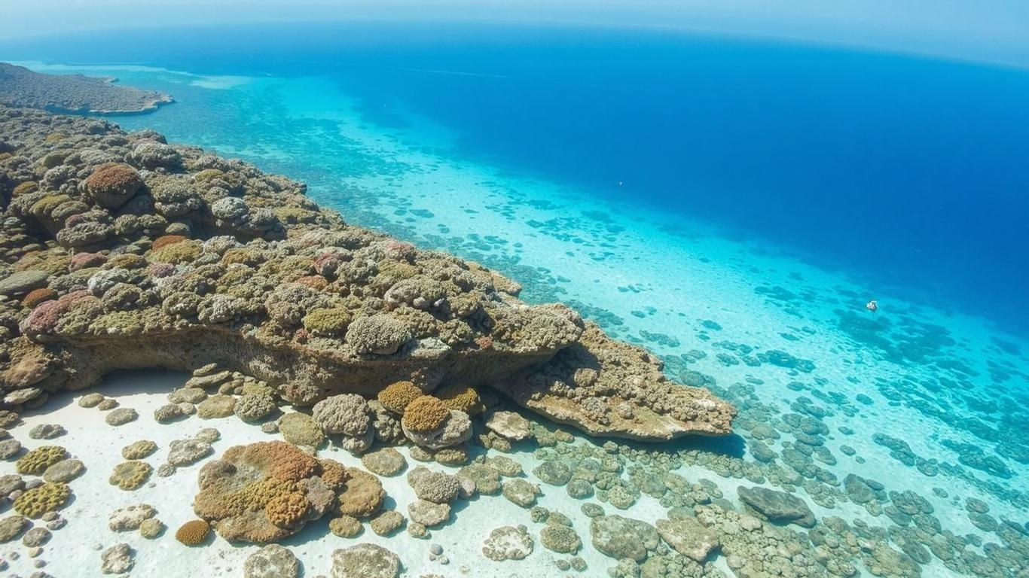

Slide 5
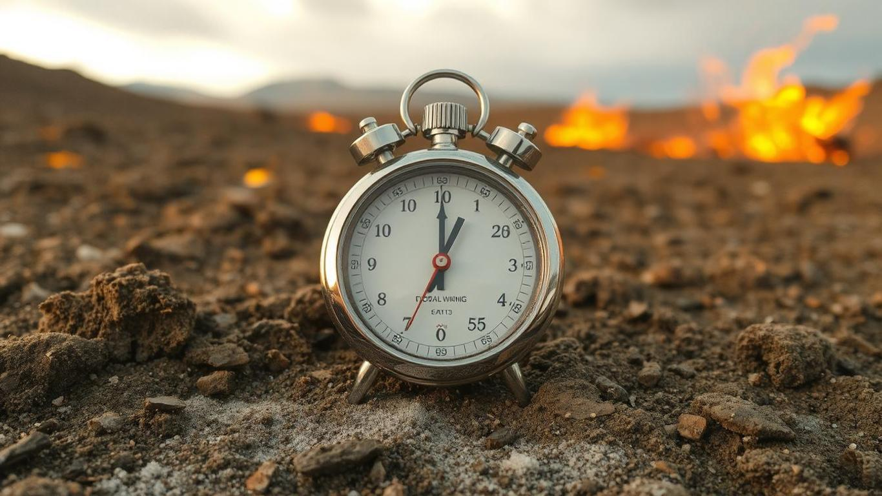

Slide 6
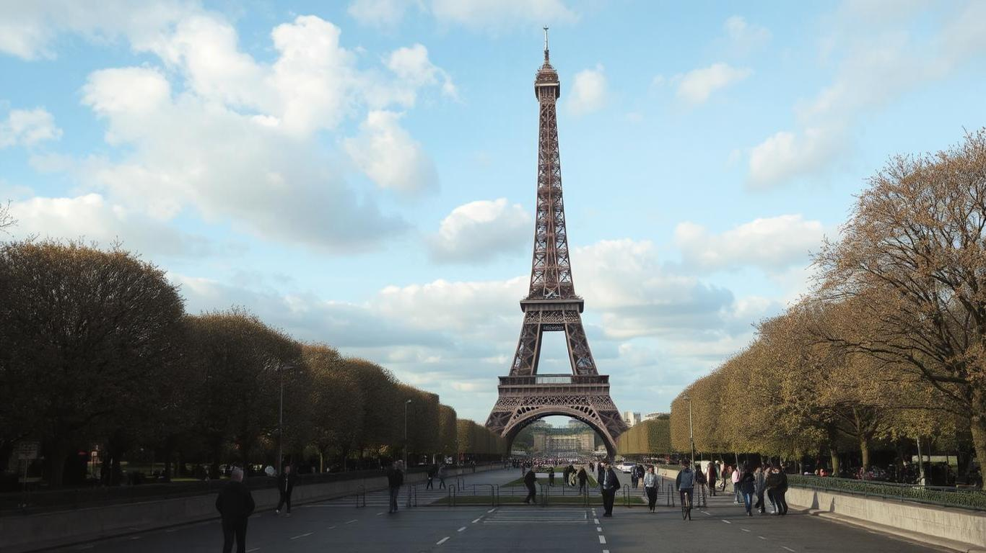

Slide 7
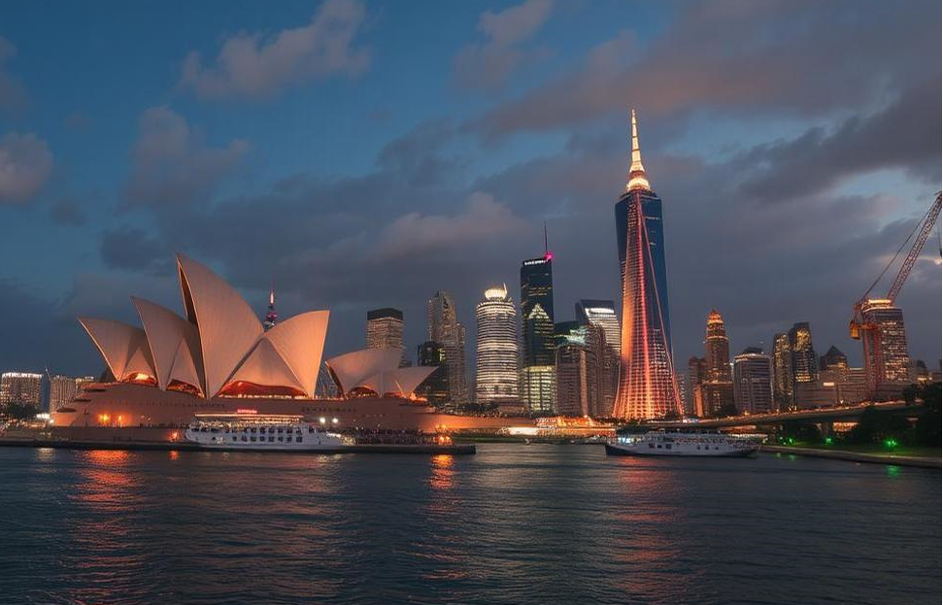
though home to just 0.3% of the global population, ranks among the top per-capita carbon emitters in the world. Our role, therefore, is small in size—but large in impact.
Are we on track to meet our Paris targets by 2030 and net-zero by 2050?
2030:
- 43% reduction in GHG emissions (from 2005 baseline)
- 82% renewable electricity generation
2050:
- Net Zero GHG Emissions
Gross emissions (from human activity) – Removals (e.g., carbon offsets, afforestation, carbon capture) = 0 net emissions
It does not mean zero emissions across the board, but that any emissions produced are counterbalanced by carbon sinks or offsets.
In practice:
Phasing out fossil fuels
Electrifying transport and industry
Expanding renewable energy
Investing in carbon capture, storage, and nature-based solutions (like tree planting or restoring wetlands)

Slide 9
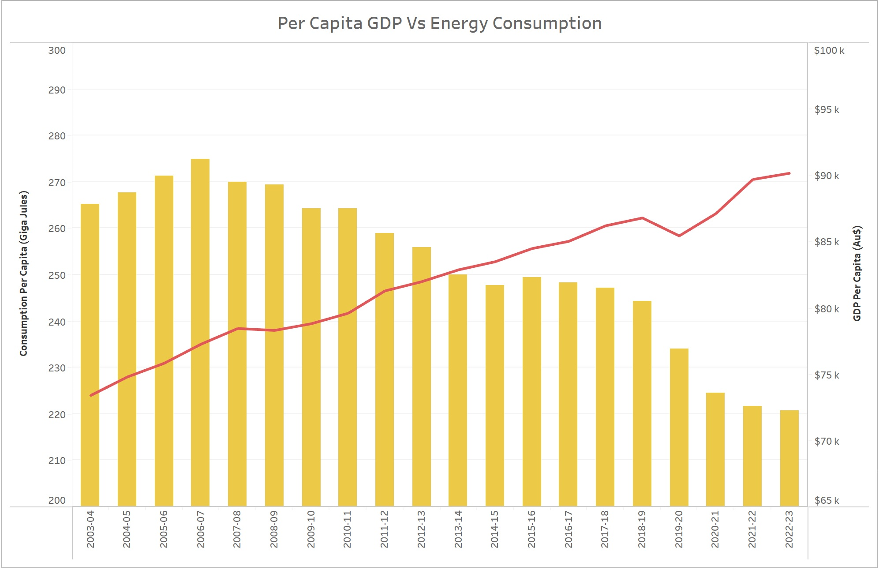

Slide 12
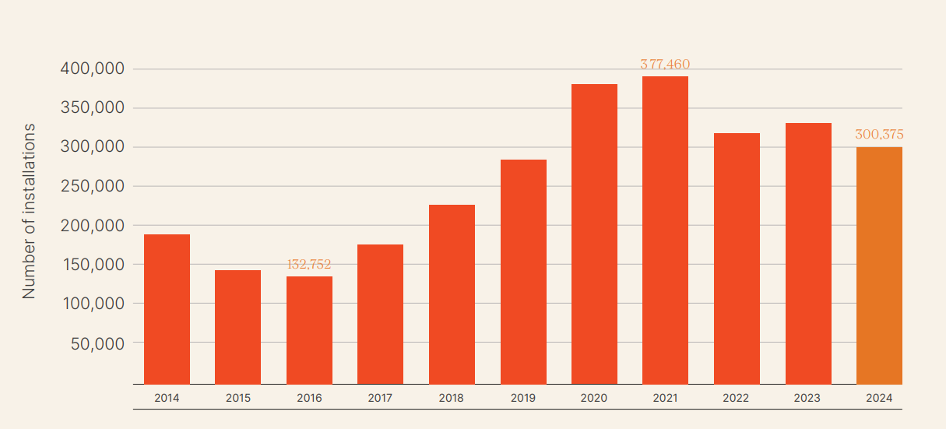
In November 2024, rooftop PV celebrated a significant milestone, surpassing four million installations and a cumulative total capacity of 25.5 GW. Australia continues to be a leading nation in per capita electricity generation from solar. In 2023 it ranked first ahead of United Arab Emirates and the Netherlands with 1,774 kWh of electricity generation from solar power per person
More than 1 in 3 homes in South Australia have rooftop solar—proof that individuals can lead change.
National number of Rooftop Solar Installations by year

Slide 13
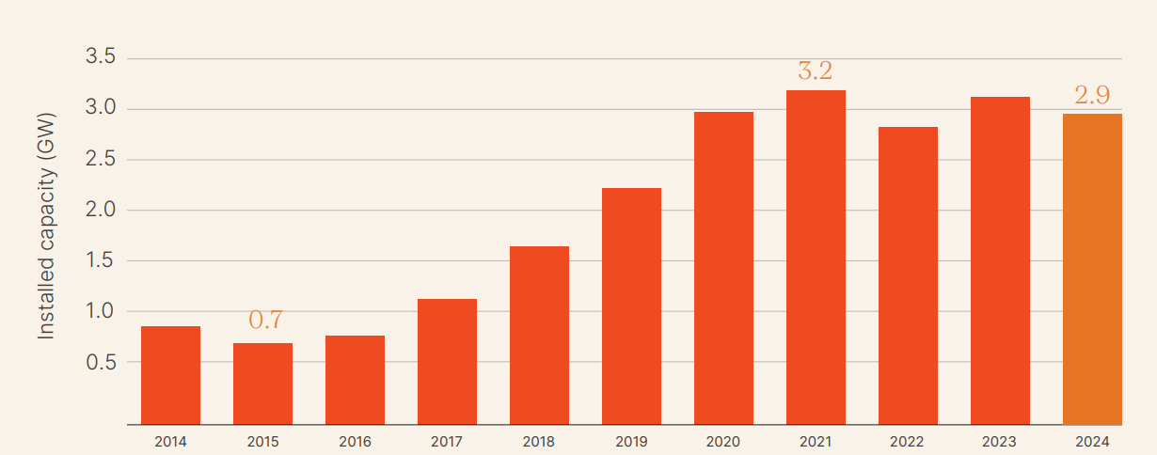
National installed rooftop PV capacity (GW), by year

Slide 14
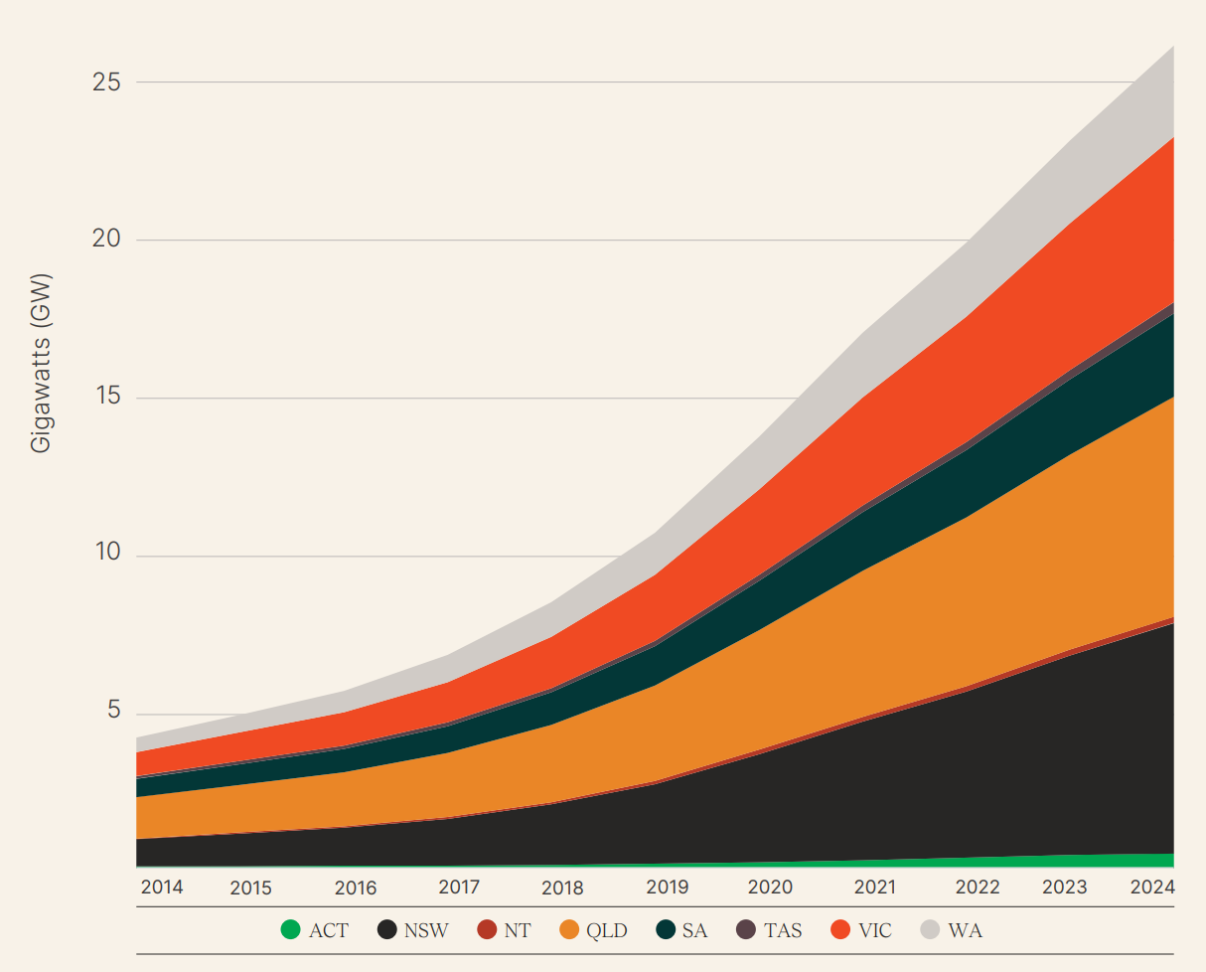
Cumulative Annual Capacity of Australian States’ Rooftop PV

Slide 15
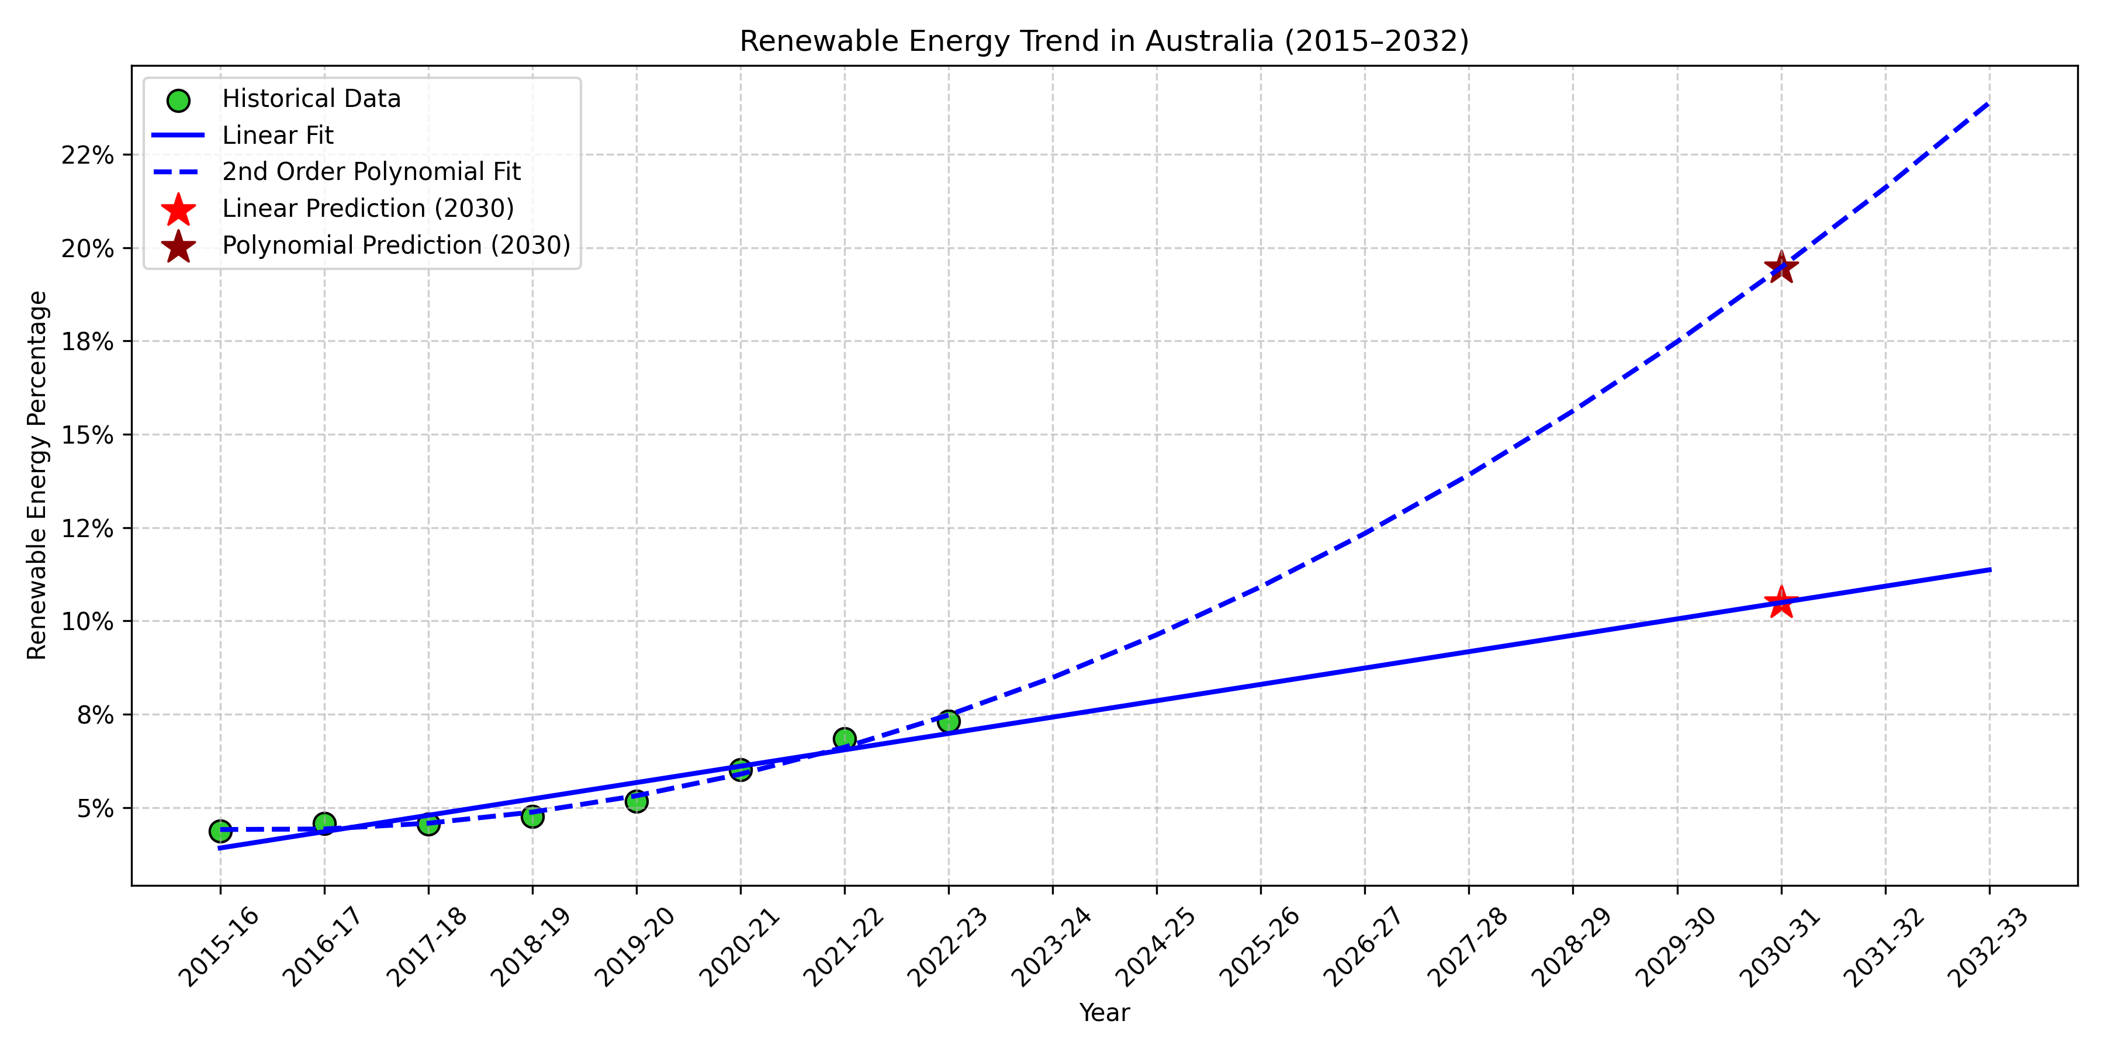
Overall rating: Insufficient (< 3°C World)
Policies and action against modelled domestic pathways: Insufficient
NDC target against modelled domestic pathways: Insufficient
NDC target against fair contribution to global climate efforts: Insufficient
Climate finance: Critically insufficient
If we continue on our current course, we overshoot the target. New policies must be bolder.
Source: https://climateactiontracker.org/countries/australia/

Slide 17
